Slide 1
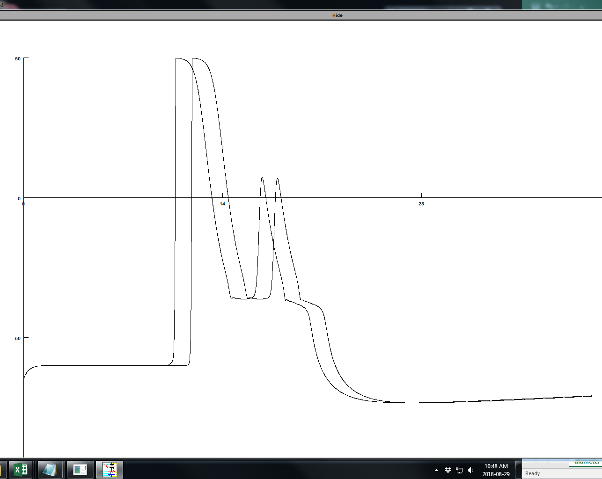
Model # 481 two spike times

